Slide 1

DEPARTMENT OF COMPUTER SCIENCE & ENGINEERING
SCHOOL OF COMPUTING
1156CS701- MAJOR PROJECT
INTERNSHIP THROUGH PLACEMENT
COGNIZANT TECHNOLOGY SOLUTIONS
WINTER SEMESTER(21-22)
SEMESTER END PROJECT VIVA VOCE EXAMINATIONS
“HUMAN VOICE EMOTION RECOGNITION USING
MULTILAYER PERCEPTRON”
SUPERVISED BY
Mrs. Femi.D
Assistant Professor
PRESENTED BY
1. M.SAHITH REDDY(12241)(18UECS0554)
2. CH.BHARGAVI (14141)(18UECS0124)
3. G.SWETHA REDDY(14145)(18UECS0267)

Slide 2
INDUSTRY DETAILS
Industry Name/Institute Name :COGNIZANT
Duration of Internship :Feb 2022-Jun 2022
Duration of Internship :4 Months
Industry Guide Name : NATARAJAN MURALI-896154
Industry Mobile Number : 9345093489

Slide 3
AGENDA
ABSTRACT
OBJECTIVE
INTRODUCTION
LITERATURE REVIEW (SOFT COPY OF PAPERS TO BE LINKED AS HYPERLINK)
DESIGN AND METHODOLOGIES
STANDARDS & POLICIES USED
IMPLEMENTATION
TESTING
INPUT AND OUTPUT
INCLUDE DEMO VIDEO (You Tube URL )
CONCLUSION
FUTURE ENHANCEMENTS
WEB REFERENCES LINK
REFERENCES
PLAGIARISM REPORT OF PPT
INTERNSHIP CERTIFICATE (Offer Letter and Completion certificate)
POSTER PRESENTATION

Slide 4
ABSTRACT
Emotion recognition is a rapidly growing research domain in recent years. Unlike humans, machines lack the abilities to perceive and show emotions. But human-computer interaction can be improved by automated emotions recognition, thereby reducing the need of human intervention. In this project, four basic emotions (Anger, Happy, Fear and Neutral) are analyzed from emotional speech signals. Signal processing methods are used for obtaining the production features from these signals. This has opened up another exploration field called automatic emotion recognition, having fundamental objectives to understand and retrieve desired emotions. Machines can recognize ”what is said” and ”who said it” using speech recognition and speaker identification techniques.

Slide 5
OBJECTIVES
Aim of the Project:
The primary aim of Human Voice Emotion Recognition is to improve man-machine interface. It can also be used to monitor the psycho physiological state of a person in lie detectors. In recent time, Human Voice Emotion recognition also find its applications in medicine and forensics.
Scope of the Project:
The technique of detecting the mood or condition of a person through voice is an emerging thought where the usefulness of this process is inevitable, and will share its uses with many sectors from medical to information technologies.

Slide 6
INTRODUCTION
Emotions play a mandatory important role in human life. It could be identified from the speech uttered by the person, it is a medium of expression of one’s perspective or feelings to others.
This process could be added up along with video that is, the face recognition by using its own API’s merged with voice and can be developed as a software application in future technical industry, and so that it will depict the condition of the person with whom we are interacting with.
It will be more and more useful for person abroad with their relatives and parents in their hometown.
Human Voice emotion processing and recognition system was generally composed of three parts, which were speech signal acquisition, feature extraction, and emotion recognition.

Slide 7
LITERATURE REVIEW
Sardar, A. A. M., Islam, S., & Bhuiyan, T. (2021). A Review on Automatic Speech Emotion Recognition with an Experiment Using Multilayer Perceptron Classifier. In Soft Computing Techniques and Applications (pp. 381-388). Springer, Singapore.
Human–machine interaction is becoming popular day by day; to interact with machine, speech emotion recognition is as important as human to human interaction. In this research, we demonstrate a speech emotion recognition system which takes speech as input and classify emotions that the speech contains. Algorithms such as Logistic Regression, Support Vector Machine, Multilayer Perceptron, Convolutional Neural Network (CNN), and Long Short-Term Memory (LSTM).

Slide 8
LITERATURE REVIEW
Mokgonyane, T. B., Sefara, T. J., Modipa, T. I., Mogale, M. M., Manamela, M. J., & Manamela, P. J. (2019, January). Automatic speaker recognition system based on machine learning algorithms (pp. 141-146). IEEE.
This paper presents the development of an automatic speaker recognition system that incorporates classification and recognition of Sepedi home language speakers. Four classifier models, namely, Support Vector Machines, K-Nearest Neighbors, Multilayer Perceptron (MLP) and Random Forest (RF), are trained using WEKA data mining tool. Auto-WEKA is applied to determine the best classifier model together with its best hyper-parameters.

Slide 9
LITERATURE REVIEW
Berkane, M., Belhouchette, K., & Belhadef, H. (2019). Emotion recognition approach using multilayer perceptron network and motion estimation. International Journal of Synthetic Emotions (IJSE), 10(1), 38-53.
They have adopted independent component analysis (ICA) as the extraction method and MLP as the model classifier. In the field of emotion recognition, multilayer perceptron is widely used. The second emotional recognition source is the neurological signals, like is developed by Kumar (Kumar et al., 2019), their system used an EEG to recognize emotions.

Slide 10
DESIGN AND METHODOLOGIES
Multi-layer perceptron:
A novel Multi-Layer Perceptron (MLP)-based speech recognition method is proposed in this study.
A Multi-Layer Perceptron (MLP) is a feed forward artificial neural network that generates a set of outputs from a set of inputs.
The MLP formed by three or more layers (an input and an output layer with one or more hidden layers which are directly connected in graph) of nonlinearly-activating nodes.
Multilayer Perceptron are often applied to supervised learning problems. They train on a set of input-output pairs and learn to model the correlation (or dependencies) between those inputs and outputs.

Slide 11
The Network being real values. If you have classified data, such as attribute 1 with the values “male” and “female”, emotion attributes 2 such as “happy”, “sad”, “angry” etc. you can convert it to a real valued representation which is called a one hot encoding.
The input given to the model should be the features extracted along with the emotion category that it belongs to, and stored correspondingly into respective arrays so that, classifier will be able to identify the patterns, correlations and then classify the data.
This training helps the model to understand, which emotions have what range of the respective features. So, when an unseen data is given as an input, it will be able to correlate and predict the emotion.

Slide 12
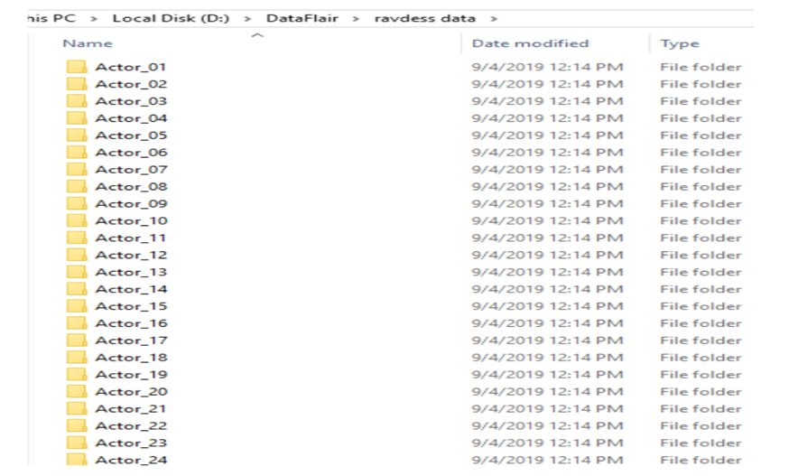
MODULE:1
Data Collection and training using Machine Learning Algorithms.
Step:1 Collection of data

Slide 13
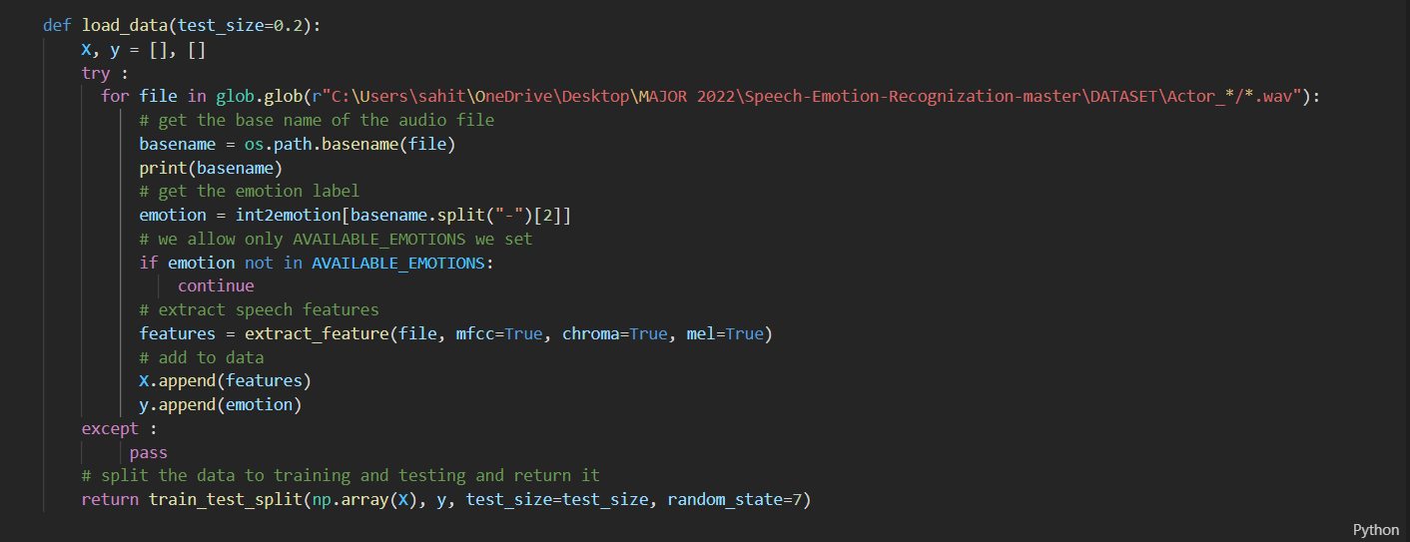
Step 2: Pre-Processing of data

Slide 14
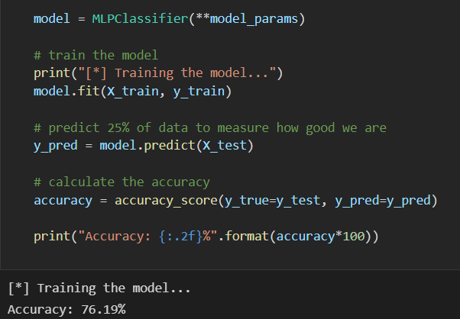
Step 3:Apply Machine Learning Algorithm and Training the model

Slide 15
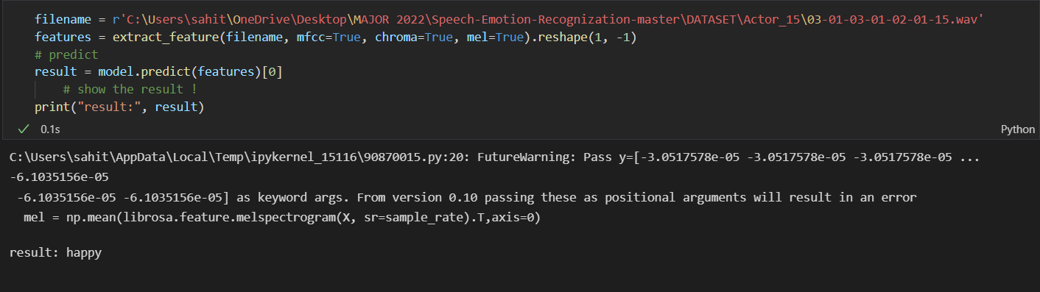
Step 4:Get the Output

Slide 16
STANDARDS & POLICIES
• IEEE 829 - Software Test Documentation
• IEEE 830 -Software Requirements Specifications
• IEEE1012- Software verification and validation
• IEEE 1016 - Software design description

Slide 17
IMPLEMENTATION
ARCHITECTURE DIAGRAM
DATA FLOW DIAGRAM

Slide 18
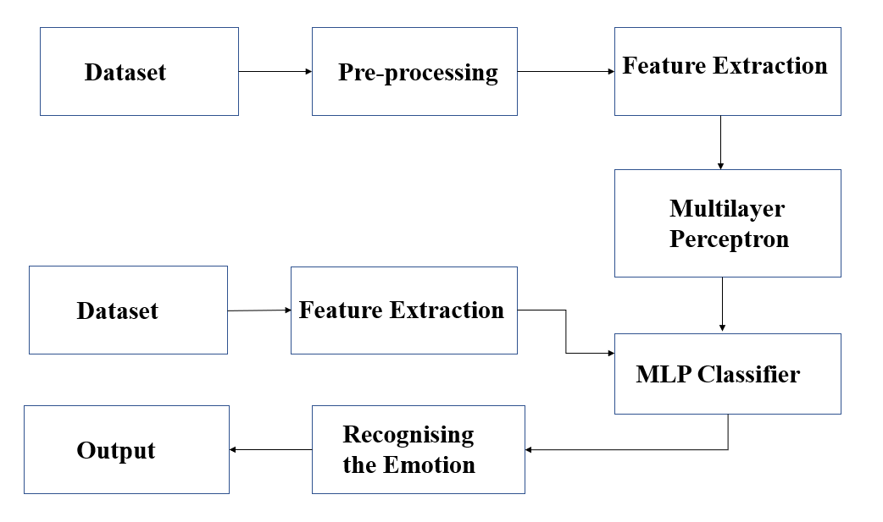
ARCHITECTURE DIAGRAM

Slide 19
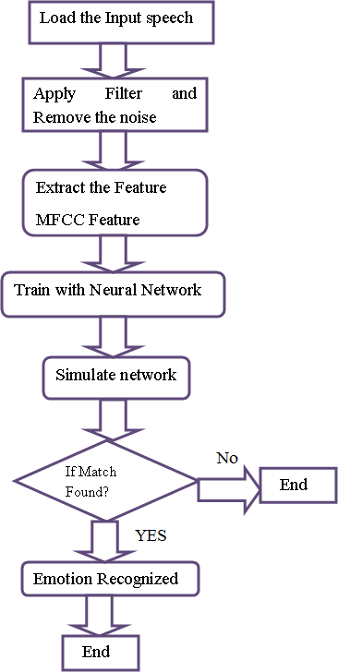
DATA FLOW DIAGRAM

Slide 20
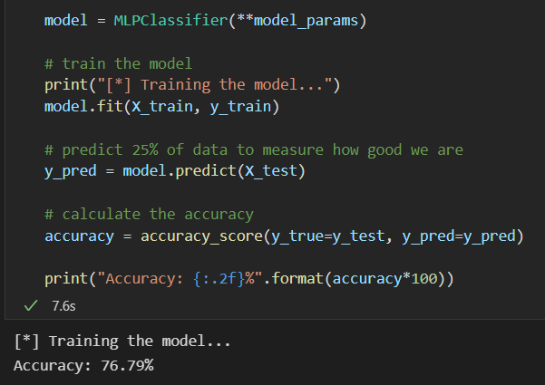
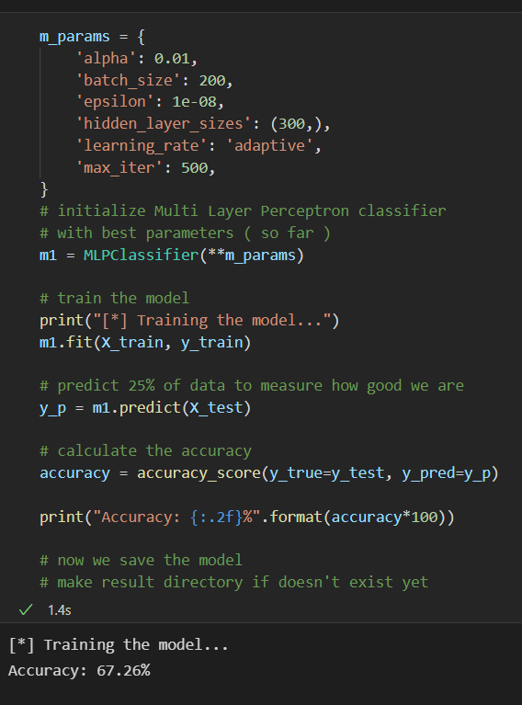
TESTING
UNIT TESTING
Unit testing involves the testing of each unit or an individual component of the software application. It is the first level of functional testing. The aim behind unit testing is to validate unit components with its performance . A unit is a single testable part of a software system and tested during the development phase of the application software.

Slide 21
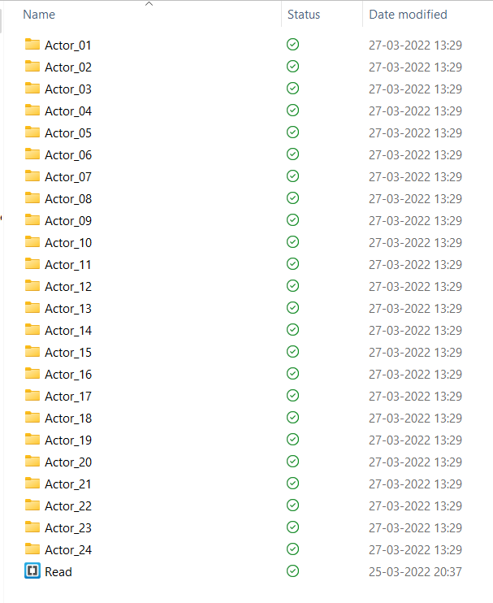
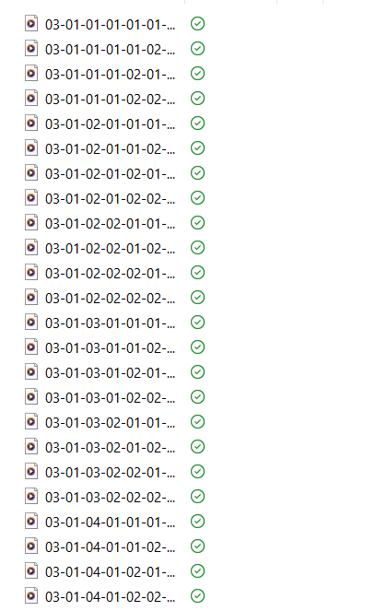
INPUT

Slide 22
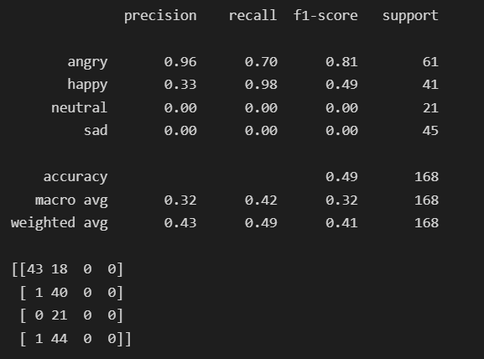
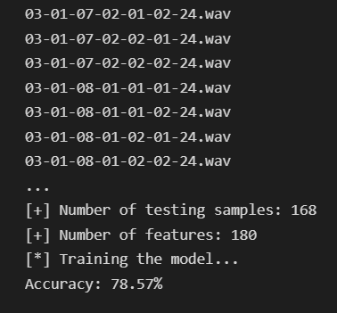
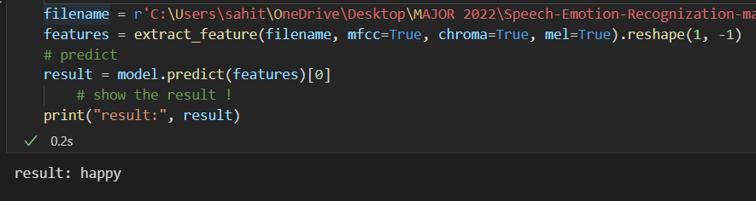
OUTPUT

Slide 23
DEMO VIDEO LINK :
https://youtu.be/XRpZjBCuVHI

Slide 24
CONCLUSION
The research over this idea fetches us the knowledge, that this techniques is yet play the vital role in medical and technical field.
In Google and Spotify music are also trying to recognise the person’s emotion and play the music according to their mood and show the information according to mood of person.

Slide 25
FUTURE ENHANCEMENTS
Human voice emotion recognition have shown how to use machine learning to gain basic knowledge of speech and basic emotions from human emotions. The system can be used for processes such as call center structure or digital assistant based on voice or chatbot linguistics. The correct use of speech rhythm can be checked to see if it can explain many of the weaknesses of the model. Find a way to clear the silence from the occasional audio clip. Browse the various sound features of the audio data to make sure it applies to the language recognition area.

Slide 26
WEB REFERENCES/VIDEO LINKS
Web References
https://extrudesign.com/speech-emotion-recognition/
https://www.researchgate.net/figure/The-Web-interface-for-emotion-recognition-from-speech_fig5_228774612
Video Links
https://youtu.be/26_qiXEa8lw
https://youtu.be/iWk9kYGQn_U
https://youtu.be/uD-PFF4KQPA

Slide 27
REFERENCES
Sardar, A. A. M., Islam, S., & Bhuiyan, T. (2021). A Review on Automatic Speech Emotion Recognition with an Experiment Using Multilayer Perceptron Classifier. In Soft Computing Techniques and Applications (pp. 381-388). Springer, Singapore.
Ho, N. H., Yang, H. J., Kim, S. H., & Lee, G. (2020). Multimodal approach of speech emotion recognition using multi-level multi-head fusion attention-based recurrent neural network. IEEE Access, 8, 61672-61686.

Slide 28
REFERENCES
Mokgonyane, T. B., Sefara, T. J., Modipa, T. I., Mogale, M. M., Manamela, M. J., & Manamela, P. J. (2019, January). Automatic speaker recognition system based on machine learning algorithms (pp. 141-146). IEEE.
Berkane, M., Belhouchette, K., & Belhadef, H. (2019). Emotion recognition approach using multilayer perceptron network and motion estimation. International Journal of Synthetic Emotions (IJSE), 10(1), 38-53.

Slide 29
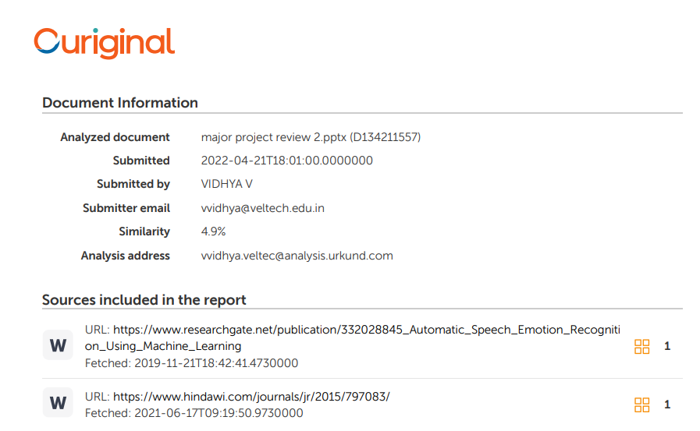
PLAGIARISM REPORT OF PPT

Slide 30
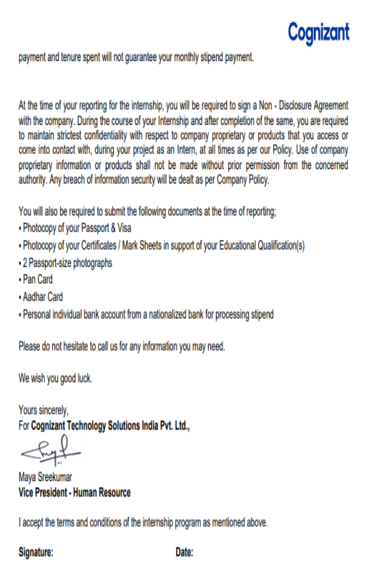

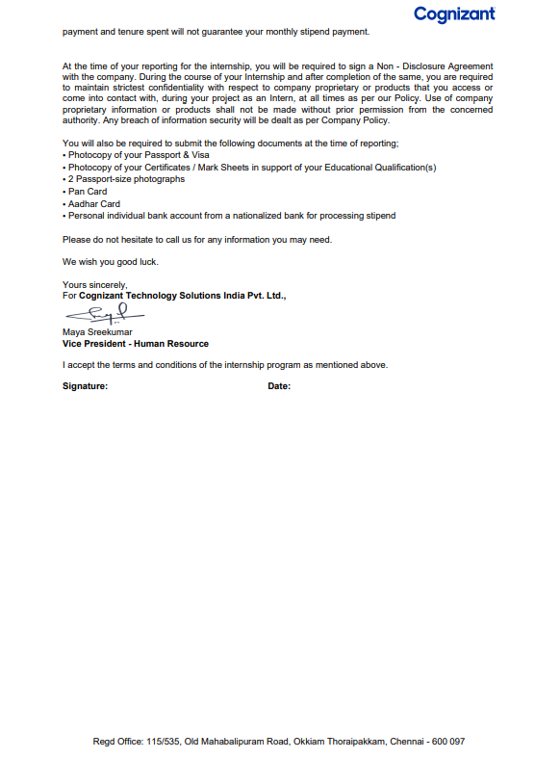
INTERNSHIP CERTIFICATE

Slide 31
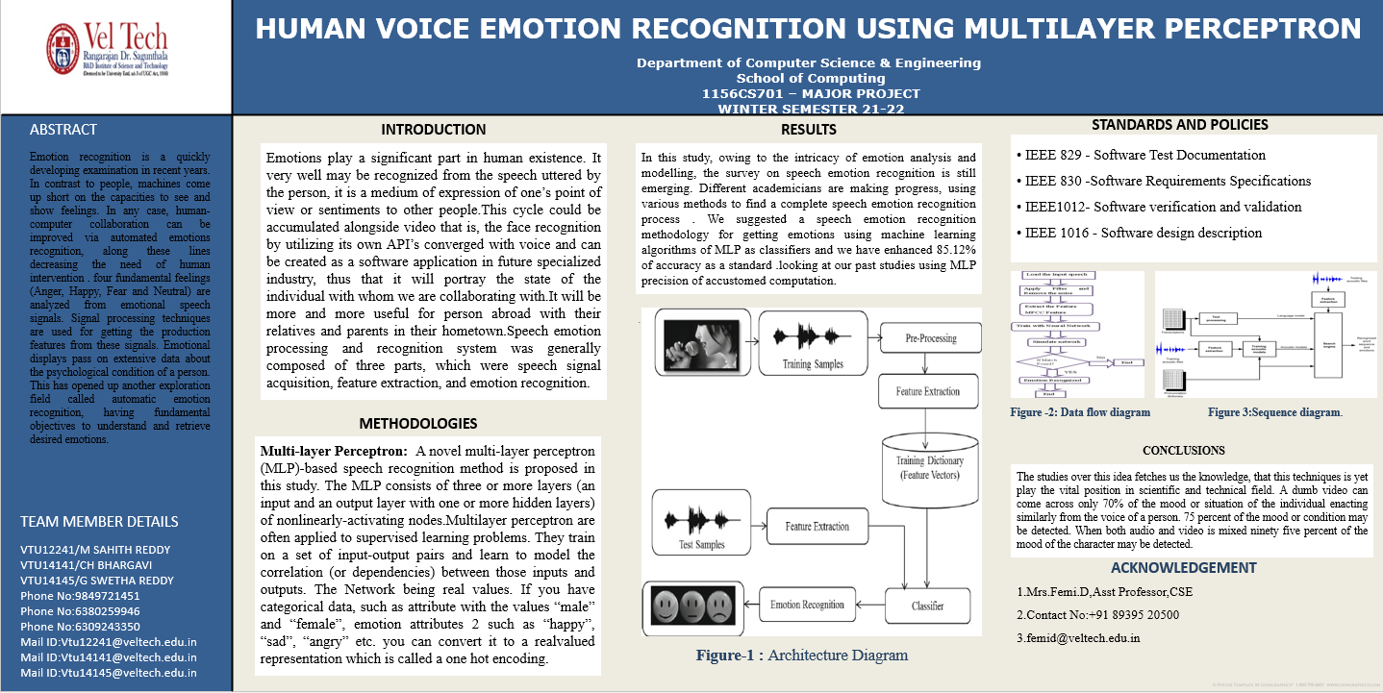
POSTER PRESENTATION

Slide 32
THANK YOU

